Slide 1

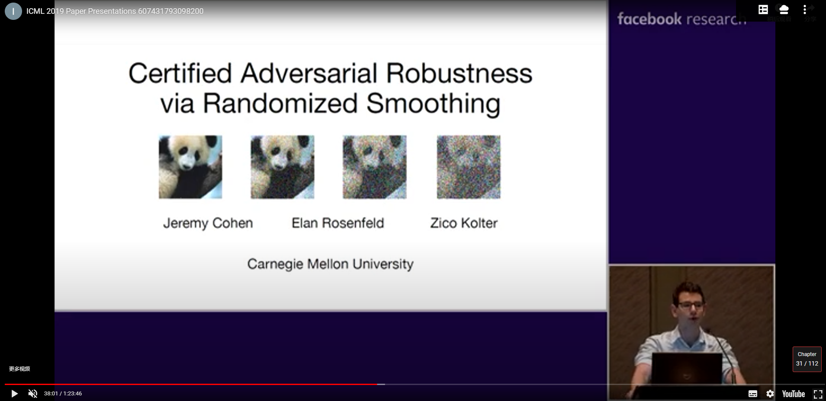
Tight Certificates of Adversarial Robustness for Randomly Smoothed Classifiers
Guanghe Lee, Yang Yuan, Tommi S.Jaakkola
MIT
NIPS 2019

Slide 2
Randomly Smoothed
Overview
How to augment the useful data to increase generalization performance of models?
Lee, Guang-He, Tommi S.Jaakkola. Tight certificates of adversarial robustness for randomly smoothed classifiers. NIPS2019.

Slide 3
Randomly Smoothed
Notation
Symbol | Definition
Lee, Guang-He, Tommi S.Jaakkola. Tight certificates of adversarial robustness for randomly smoothed classifiers. NIPS2019.

Slide 4
Randomly Smoothed
Evaluation
Experiments with randomized smoothing on ImageNet with σ = 0.25.
Left: certified accuracies obtained using CERTIFY VS. those obtained
Lee, Guang-He, Tommi S.Jaakkola. Tight certificates of adversarial robustness for randomly smoothed classifiers. NIPS2019.

Slide 5
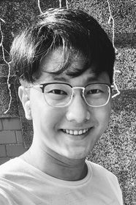
Randomly Smoothed
Authors
Guanghe Lee
PhD at MIT
Lee, Guang-He, Tommi S.Jaakkola. Tight certificates of adversarial robustness for randomly smoothed classifiers. NIPS2019.

